Slide 1
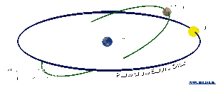
Astronomical Association of Queensland www.aaq.org.au Science Teachers Association of Queensland www.staq.qld.edu.au
Total Solar Eclipse 14 November 2012
How Eclipses Occur

Slide 2
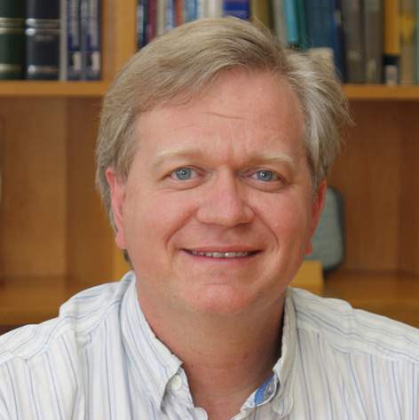
Foreword
“A total solar eclipse is one of the most dramatic astronomical events you can experience. I was lucky enough to see one when I was 12, when the Sun and Moon aligned over my childhood home, providing me with one of the most amazing experience of my life. Even if you are not lucky enough to be in this eclipse's path of totality, grab the opportunity to learn what it is all about, and how to observe the partial eclipse safely.”
Professor Brian Schmidt
Astronomer at the Research School of Astronomy
and Astrophysics at the Australian National University.
2011 Nobel Laureate in Physics.

Slide 3
WARNING:
Never look directly at the bright surface of the Sun without proper eye protection as permanent eye damage may result.
This applies at any time and especially during the partial phases of a solar eclipse.
Refer to the advice issued by the Queensland Government about how to view the eclipse safely.
http://www.fairtrading.qld.gov.au/safe-viewing-of-astronomical-events.htm

Slide 4
How Does a Solar Eclipse Occur - 1
A Solar Eclipse occurs when the Moon comes between the Earth and the Sun and casts a shadow on the Earth.
There are two parts to the Moon’s shadow:
the dark inner cone shaped part called the Umbra from which the Sun cannot be seen at all; and
the lighter outer part called the Penumbra from which part of the Sun can be seen.

Slide 5
How Does a Solar Eclipse Occur - 2
If you are in the area covered by the umbra you cannot see the Sun at all and there will be a Total Solar Eclipse.
If you are in the area covered by the penumbra you can see part of the Sun and there will be a Partial Solar Eclipse.

Slide 6
How Does a Solar Eclipse Occur - 3
As the Moon orbits the Earth and the Earth rotates, the umbra traces out a narrow path called the Path of Totality.
A Total Solar Eclipse can be seen from within the path of totality.
As the umbra approaches any location in the path, the Moon will firstly gradually cover the Sun taking about an hour.
As the umbra arrives there will be the brief total part of the eclipse.
The Moon will then gradually uncover the Sun taking about another hour.

Slide 7
How Does a Solar Eclipse Occur - 4
A Partial Solar Eclipse can be seen from the area swept by the penumbra outside the path of totality.
No eclipse can be seen outside the path covered by the penumbra.

Slide 8
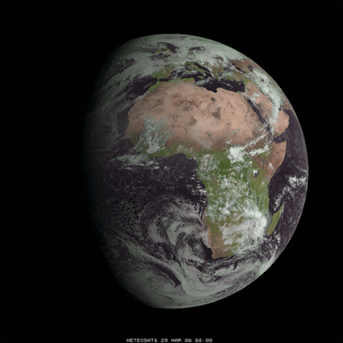
The Moon’s shadow on the Earth
To be deleted if no approval to use image
Time lapse of the Moon’s shadow for the total solar eclipse of 29 March 2006.
EUMETSAT Meteosat-8 imagery. Animation by the Space Science Engineering Center at University of Wisconsin.

Slide 9
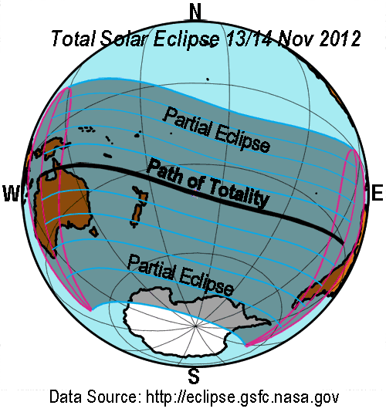
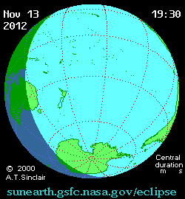
Path of the 14 Nov 2012 Eclipse
Note: Dates and times in these diagrams are in Universal Time (GMT)
The narrow path of totality will cross northern Australia, then cross the Pacific Ocean making no further landfall.
A partial eclipse will occur over a much greater area.

Slide 10
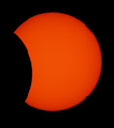
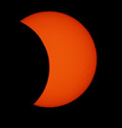
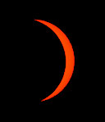
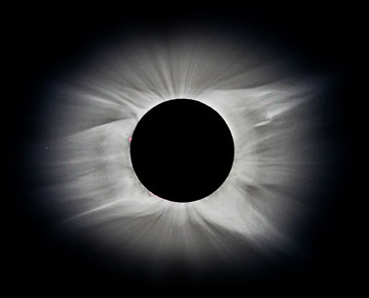
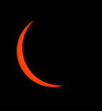
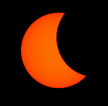
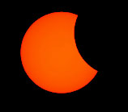
Sequence of a Total Solar Eclipse
The Moon takes about an hour to cover the Sun in the initial partial phase.
The Moon completely covers the Sun for the brief total eclipse.
The Sun’s corona can be seen surrounding the Moon.
The Moon takes about an hour to uncover the Sun in the end partial phase.

Slide 11
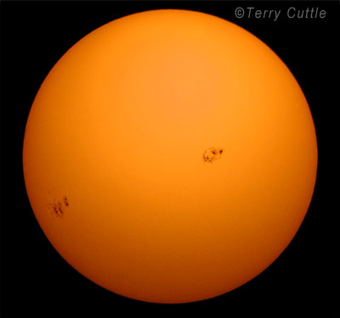
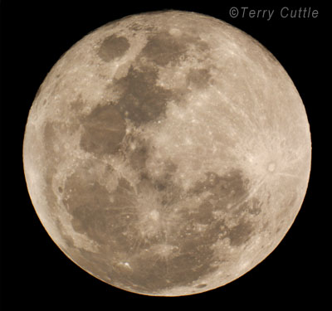
The Sun and Moon appear to be about the same size – but are actually very different
Sun’s diameter: 1 392 000 km
Sun’s distance : 149 598 000 km
Moon’s diameter: 3 476 km
Moon’s distance : 384 400 km
Sun’s diameter compared to Moon’s: 1 392 000 / 3 476 = 400
Sun’s distance compared to Moon’s: 149 598 000 / 384 400 = 389

Slide 12
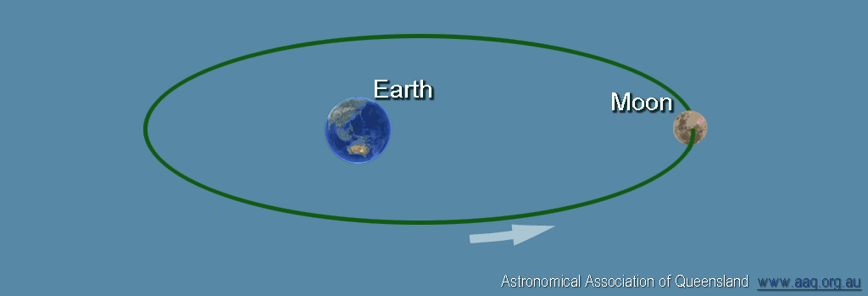
Variation in Size of the Moon - 1
Perigee
(min. distance)
356 400 km
Apogee
(max. distance)
406 700 km
Moon’s Elliptical Orbit diagram here
The Moon travels in an elliptical orbit around the Earth.
Sometimes it is closer to the Earth and sometimes further away.
So, sometimes it appears larger and at other times it appears smaller.

Slide 13
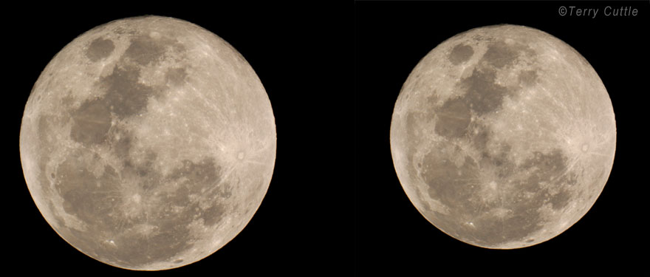
Variation in Size of the Moon - 2
Moon at Perigee: 356 400km
Moon at Apogee: 406 700 km
At Perigee the Moon appears large enough to cover the Sun.
At Apogee the Moon appears too small to cover the Sun.

Slide 14
Annular Eclipse - 1
An Annular Eclipse occurs when the Moon comes between the Earth and the Sun but the Moon does not appear large enough to cover the Sun.
The umbra does not reach the Earth. The extension of the umbra is called the Antumbra.
From within the antumbra the Moon appears too small to completely cover the Sun and a ring of bright Sun surrounds the Moon.

Slide 15
Annular Eclipse - 2
For any location within the antumbra a ring of the Sun remains and there will be an Annular Eclipse.
From within the penumbra, as with a total eclipse, the Sun will be partially covered and there will be a Partial Solar Eclipse.

Slide 16
Annular Eclipse - 3
As the Moon orbits the Earth and the Earth rotates, the antumbra traces out a path called the Path of Annularity.
An Annular Eclipse can be seen from within the Path of Annularity.
A partial solar eclipse can be seen from the area swept by the penumbra.
No eclipse can be seen outside the path of the penumbra.

Slide 17
Annular Eclipse - 4
From the path of annularity:
the Moon gradually covers up the Sun in the initial partial phase;
at maximum the Moon moves in front of the Sun and if it is too small to completely cover the Sun a ring or annulus of bright sunlight remains;
then the Moon moves on to uncover the Sun in the final partial phase.
The remaining ring of sunlight makes it too bright to be able to see the Sun’s corona and the sky does not go very dark.

Slide 18
Hybrid Eclipse
When there is a close match between the apparent sizes of the Sun and the Moon, the umbra will be just long enough to reach the Earth in the centre of the path of the eclipse.
The umbra will not be long enough to reach the Earth at the beginning and end of the path.
The eclipse will start annular, change to total and then change back to annular. This is called a Hybrid Eclipse.

Slide 19
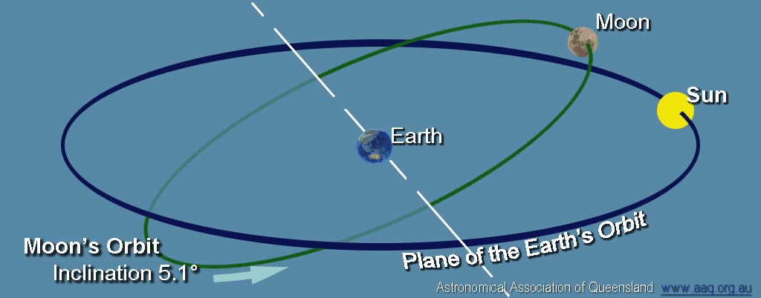
When Can an Eclipse Occur - 1
You might think that there should be a solar eclipse every new moon when the Moon passes between the Earth and the Sun.
Because the Moon’s orbit is tilted at 5º compared to the plane of the Earth’s orbit, at each new moon the Moon usually passes above or below the Sun in the sky and no eclipse occurs.

Slide 20
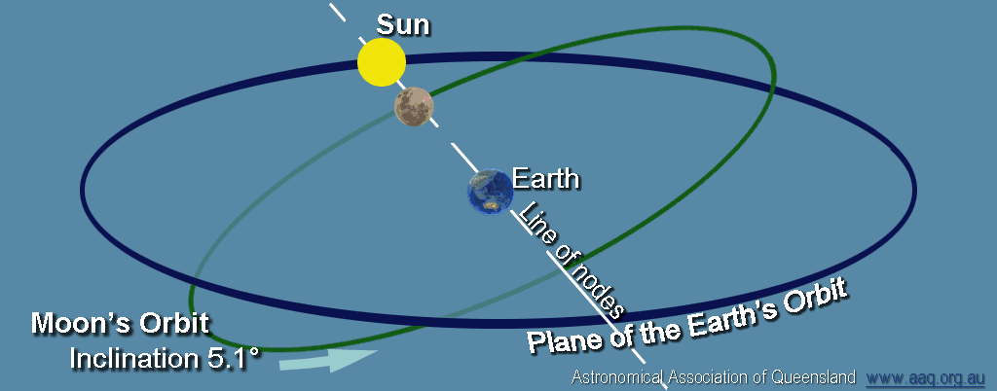
When Can an Eclipse Occur - 2
The points at which the Moon’s orbit crosses the plane of the Earth’s orbit are called Nodes.
An eclipse is only possible when the new moon is near one of the nodes.

Slide 21
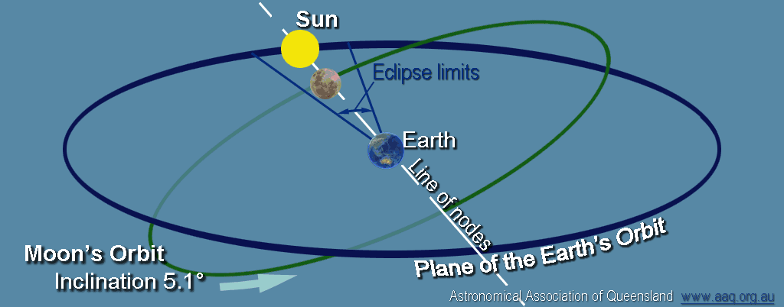
When Can an Eclipse Occur -3
There is an Eclipse Season about every 6 months when the Sun is close to one of the nodes and an eclipse is possible.
In 2012 this occurs in May (eclipse on 20 May 2012) and November (when the eclipse occurs in North Queensland).

Slide 22
Frequency of Eclipses
Total Solar Eclipses occur somewhere on the Earth on average about once every 18 months.
Annular Eclipses occur slightly more frequently than total solar eclipses.
The maximum number of solar eclipses in any one year is five (of which four will be partial).
Solar eclipses repeat in a regular pattern called a Saros which is 18 years 11¹/₃ days.
Because each total solar eclipse occurs on a narrow path across the Earth, the average time between total solar eclipses for any specific location is 350 to 400 years but this interval can vary widely.

Slide 23
The Saros Story
Eclipses repeat in a pattern every 18 years 11¹/₃ days called a Saros. This is because this period is a multiple of:
223 lunar months (period from one full moon to the next);
19 eclipse years (period between 2 node crossings); and
239 Anomalistic months (apogee – perigee – apogee period).
Eclipses each belong to a saros family.
The 2012 eclipse belongs to saros number 133.

Slide 24
The Coincidence of Solar Eclipses
The Sun and the Moon appear to be about the same size.
The Sun is about 400 times the diameter of the Moon.
The Sun is about 400 times further away.
This “perfect fit” adds to the eclipse spectacle.
The Moon is gradually moving further from the Earth – eventually total solar eclipses will no longer occur.

Slide 25
Astronomical Association of Queensland www.aaq.org.au Science Teachers Association of Queensland www.staq.qld.edu.au
Total Solar Eclipse 14 November 2012
How Eclipses Occur
This presentation is copyright by the Astronomical Association of Queensland and the Science Teachers Association of Queensland. It may be freely reproduced and/or modified provided that it is for non-commercial purposes and the source is acknowledged.
Address any request for use of the material for commercial purposes to eclipse@aaq.org.au

