Slide 1
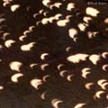
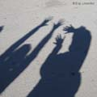
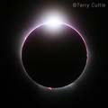
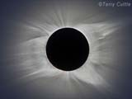
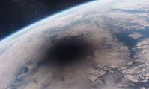
Total Solar Eclipse 14 November 2012
Astronomical Association of Queensland www.aaq.org.au Science Teachers Association of Queensland www.staq.qld.edu.au
What Happens During a Solar Eclipse

Slide 2
WARNING:
Never look directly at the bright surface of the Sun without proper eye protection as permanent eye damage may result.
This applies at any time and especially during the partial phases of a solar eclipse.
Refer to the advice issued by the Queensland Government about how to view the eclipse safely.
http://www.fairtrading.qld.gov.au/safe-viewing-of-astronomical-events.htm

Slide 3
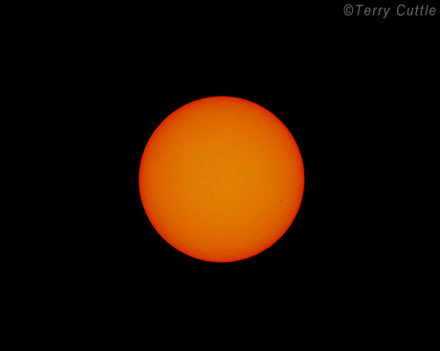
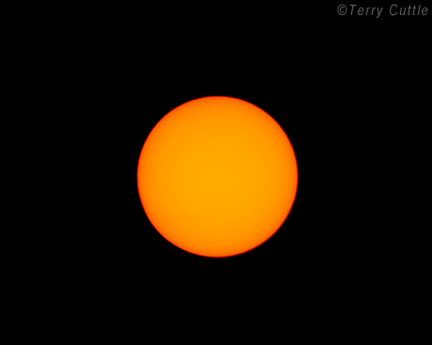
Partial and Total Solar Eclipses
A Total Solar Eclipse :
starts with a partial solar eclipse as the Moon progressively covers the Sun;
includes the dramatic total part of the eclipse when the Moon completely covers the Sun, the sky goes very dark and the Sun’s corona can be seen; and
ends with the final partial eclipse as the Moon progressively uncovers the Sun.
A Partial Solar Eclipse occurs at the same time but over a much wider area than the narrow path of the Total Solar eclipse.
The Moon progressively covers the Sun, reaches a maximum coverage then uncovers the Sun.
It does not include the dramatic total part of the eclipse.
A partial eclipse occurs on either side of the path of totality.

Slide 4
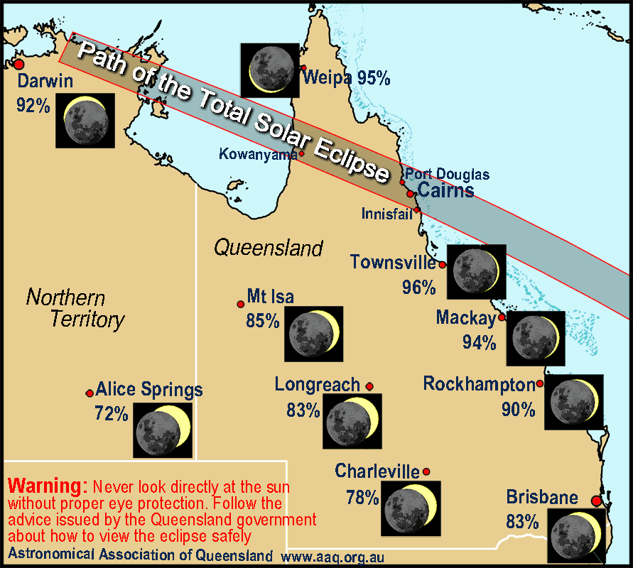
Partial and Total Solar Eclipses
Map of the solar eclipse of 14 November 2012
The area either side of the path of the total eclipse will experience a partial eclipse.
The degree of maximum coverage of the Sun depends on the distance from the path of the total eclipse.

Slide 5
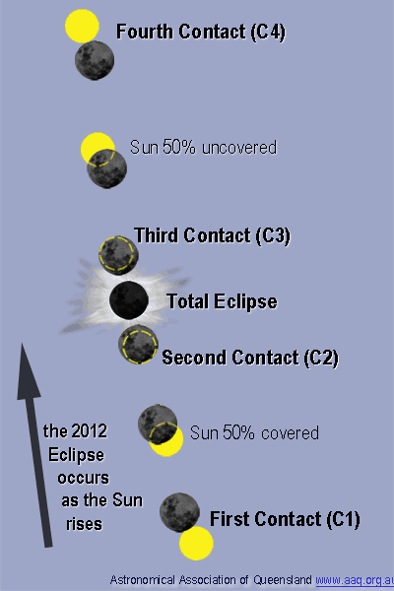
Eclipse Contacts
Contacts define the timing of an eclipse.
First Contact (C1): the Moon firstly begins to cover the Sun:
start of the initial partial phase.
Second Contact (C2): the Sun is firstly completely covered:
start of the total phase.
Third Contact (C3): the Sun is on the point of being uncovered:
end of the total phase.
Fourth Contact (C4) is when the Moon lastly touches the Sun:
end of the final partial phase.
For a partial solar eclipse there is only First Contact and Fourth Contact.

Slide 6
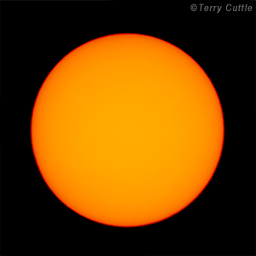
Partial Solar Eclipse Appearance
A Partial Solar Eclipse occurs when the Moon partially covers the Sun.
Appears first as a small bite out of the sun and progresses to increasing coverage.
The eclipse increases to a maximum coverage and then reduces again as the Moon moves on to uncover the Sun.
The eclipse can last for up to about three hours.
The light level will drop but often not enough for it to be noticed.
DO NOT look directly at the Sun at any time including during a partial solar eclipse – use safe observing methods.

Slide 7
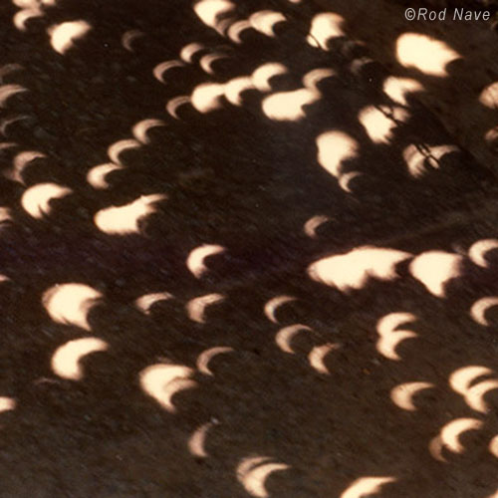
Partial Solar Eclipse Effects - 1
Look under trees or on adjacent walls for images of the crescent shape of the Sun.
The gaps between leaves on trees act as pinhole projectors.
Use household items with holes in them to project a series of crescents:
e.g., kitchen colander.
Make up a card with a series of holes punched to form words (e.g., your name) to project as crescent images.

Slide 8
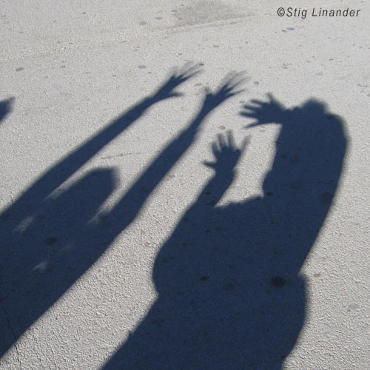
Partial Solar Eclipse Effects - 2
When the Sun is a crescent shape you can make interesting shadows.
Because the Sun is long and thin (not its usual round shape), shadows will look sharp in one direction and blurry at right angles.
Look at the shadows of both hands with the fingers on one hand orientated at right angles to the fingers on the other hand.

Slide 9
Total Solar Eclipse Appearance
The partial phases that occur before and after the total part of the eclipse are the same as a partial solar eclipse.
As totality approaches there are changes in the environment that signal that something very unusual is about to happen.
The Sun changes dramatically at the start of and during the total part of the eclipse.
During totality day turns to night and the Sun’s magnificent corona can be seen.

Slide 10
As the Total Eclipse Approaches
In the last few minutes before the eclipse becomes total, there are several changes in the environment.
The Sun becomes a very thin crescent and shadows become distinctly sharp in one direction and blurry at right angles.
The light level starts to drops quite quickly.
The temperature drops with a chill in the air.
The Moon’s shadow can be seen as an ominous darkening approaching from the west.
Animals think it is nightfall with birds often becoming excited and returning to roost.
Narrow bands of shadow (shadow bands) sometimes appear to move across the ground.

Slide 11
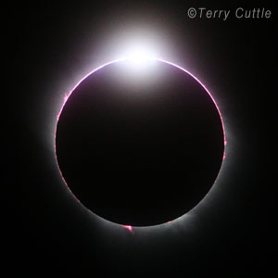
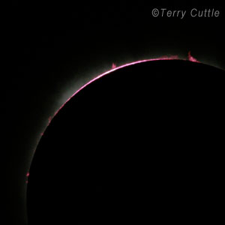
At the Start of the Total Eclipse
In the last few seconds before totality, the last brilliant point of the Sun shines through a valley on the edge of the Moon to make a “Diamond Ring”.
At the start of totality the Sun’s pink upper surface, the Chromosphere (made of glowing hydrogen) forms an arc around the edge of the Moon often with Prominences (pink loops of hydrogen plasma) rising above the surface.

Slide 12
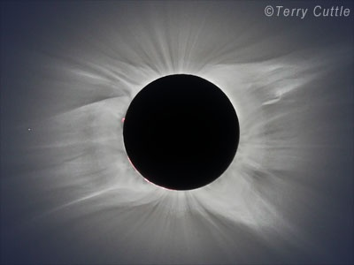
The Disappearance of the Sun
During a total solar eclipse the Moon completely covers the Sun.
The sky goes very dark very quickly – an amazing change - just like switching from day to night.
The Moon appears as a black disk surrounded by the Sun’s outer atmosphere, the corona.

Slide 13
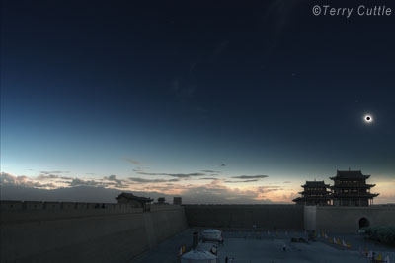
Dramatic Changes in the Sky
At totality the Moon’s shadow arrives and the sky becomes very dark very quickly.
Similar brightness as nighttime with a full moon.
The Moon’s shadow can be seen in the sky.
It is usually dark enough to see bright stars and planets.
There are sunset colours all around the horizon caused by the scattering of different wavelengths of light.

Slide 14
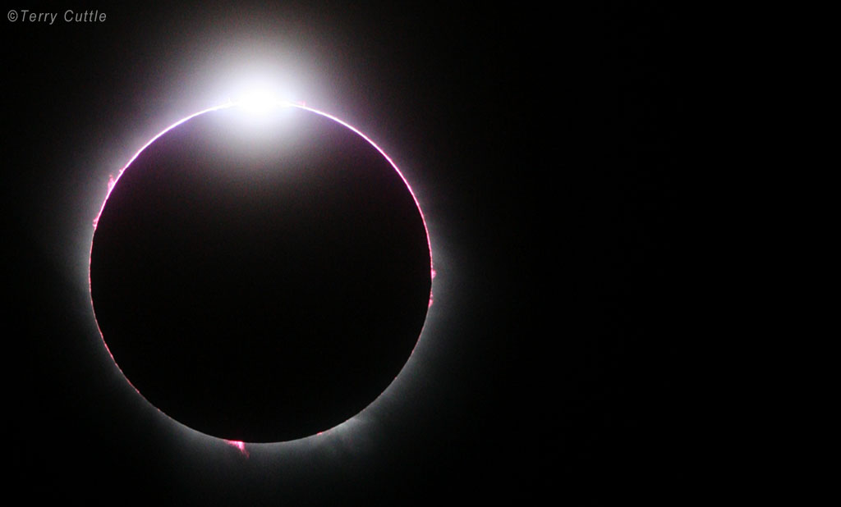
Total Solar Eclipse – Diamond Ring
Total Solar Eclipse April 2005, South Pacific Ocean
The Sun is shining through a valley on the Moon’s edge to form a Diamond Ring.
This total eclipse was about 30 seconds long because the Moon was only just big enough to cover the Sun.
The Sun’s pink chromosphere can be seen in an arc around the Moon.
There are several prominences rising above the surface.

Slide 15
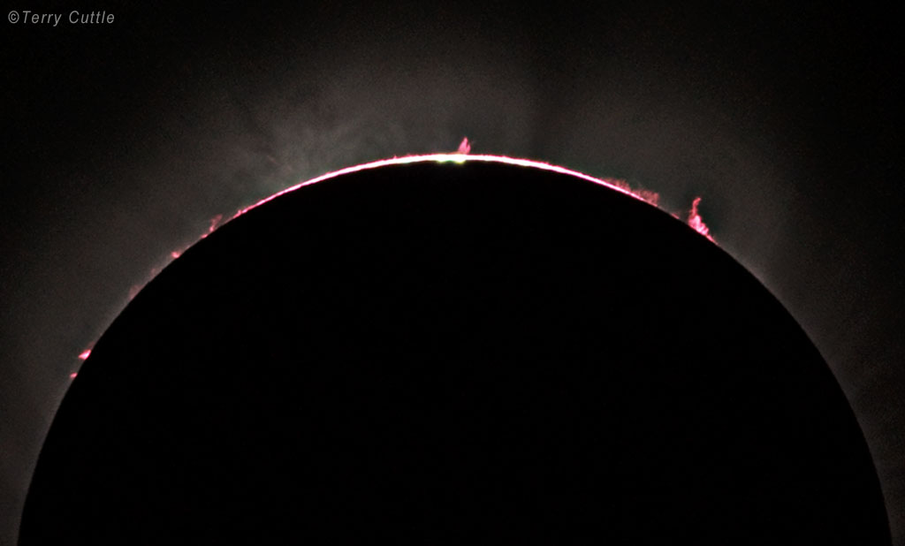
Total Solar Eclipse – Second Contact
Total Solar Eclipse March 2006, Egypt
This is Second Contact showing the Chromosphere in an arc around the Moon and Prominences.

Slide 16
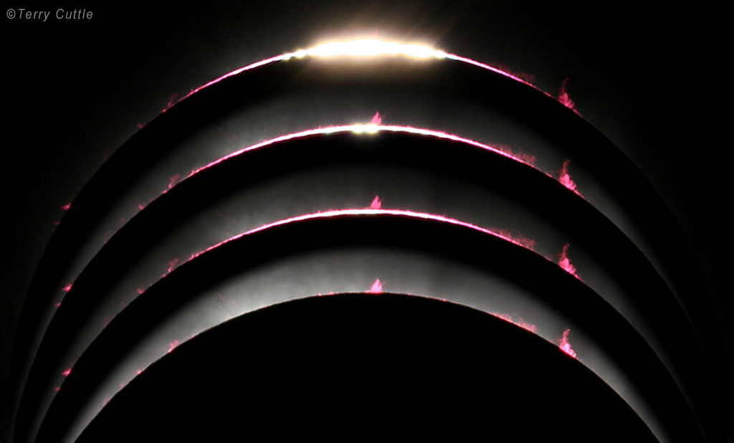
Total Solar Eclipse – Second Contact
Second Contact less 4 secs
Second Contact
Second Contact plus 2 secs
Second Contact plus 23 secs
Total Solar Eclipse March 2006, Egypt – combined images
The Moon is advancing over the Sun, covering the last part of the Sun’s surface, the chromosphere and prominences.

Slide 17
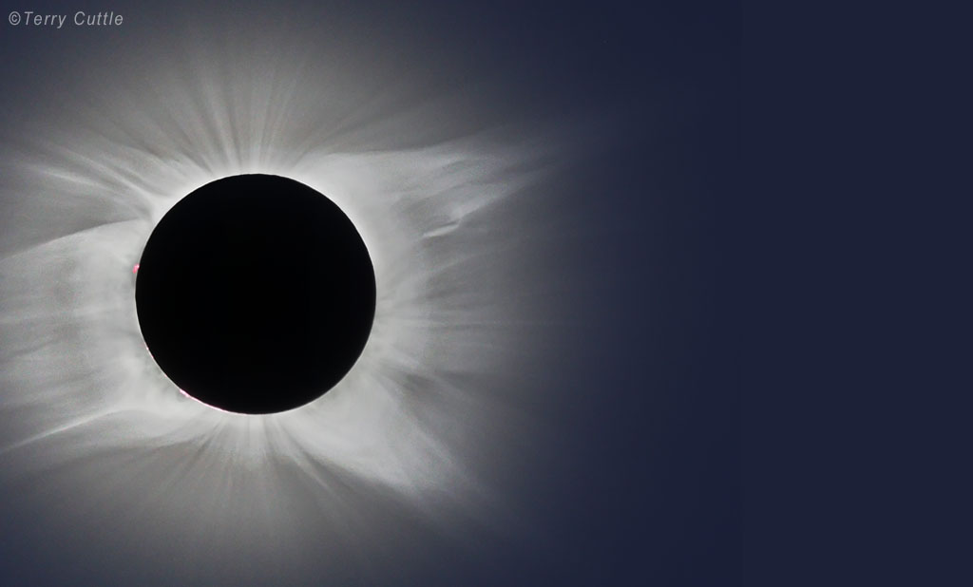
The Corona
Total solar eclipse of July 2010, French Polynesia
The corona is a tenuous layer of extremely hot gas that surrounds the Sun.
It is one of the dramatic sights of a total solar eclipse.
The corona is continuously varying and is different at each eclipse.
The corona streams out from the Sun in a pattern formed by the Sun’s magnetic field.
Thin rays of the corona called polar tufts usually appear at the Sun’s north and south poles.
Streamers usually surround the Sun at sunspot maximum.

Slide 18
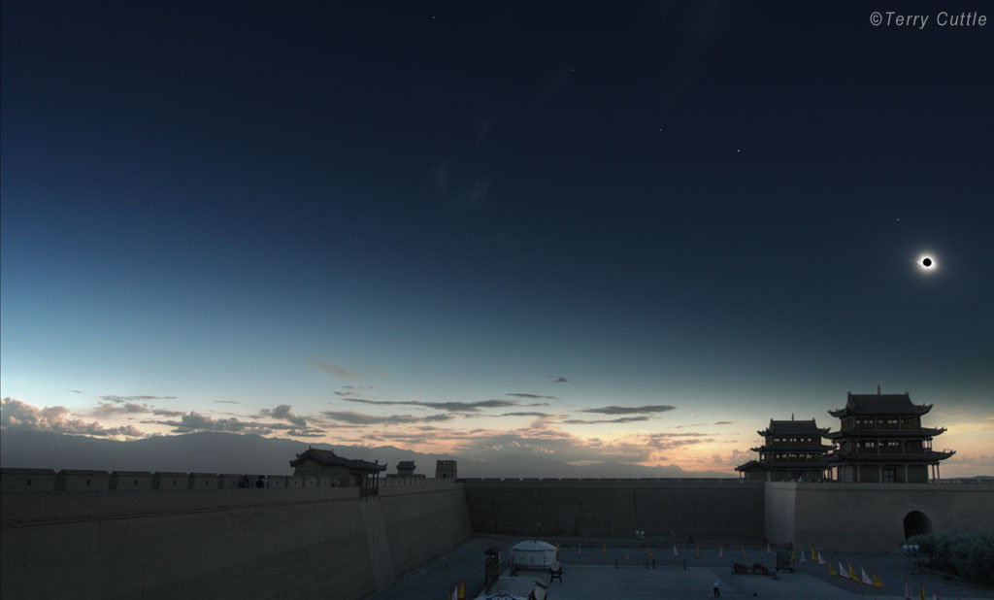
Total Solar Eclipse - The Sky
Mars
Saturn
Venus
Mercury
Total Solar Eclipse August 2008, China
The Moon is a black disk surrounded by the Sun’s corona.
The Moon’s shadow makes the sky very dark.
There are sunset colours around the horizon.
There are stars and planets in the sky.
The Sun, Moon and planets are in a line because they are all roughly in the same plane.

Slide 19
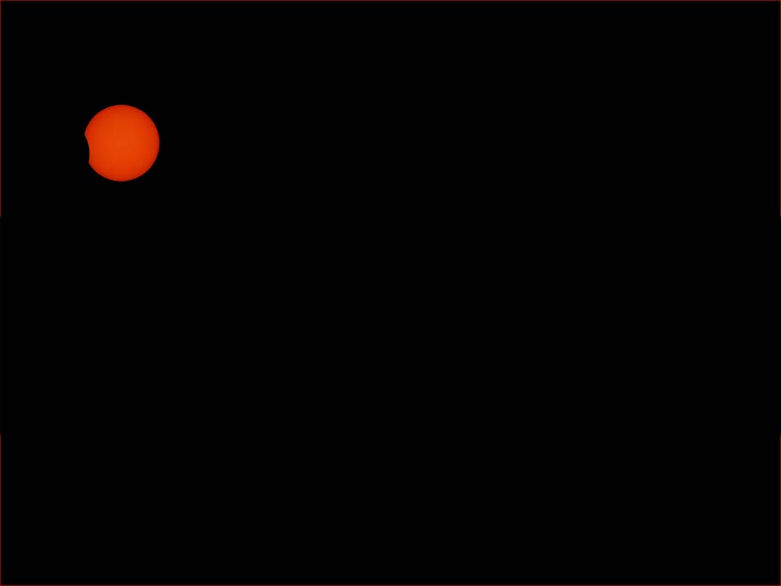
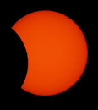
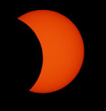
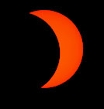
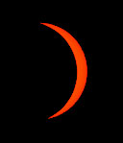
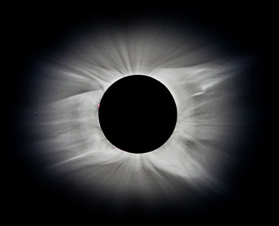
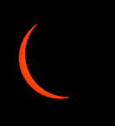
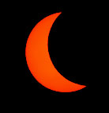
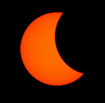
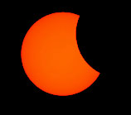
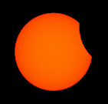
Sequence of a Total Solar Eclipse
The Moon takes about an hour to cover the Sun in the initial partial phase.
The Moon completely covers the Sun when the eclipse is total.
The Sun’s corona can be seen surrounding the Moon.
The Moon takes about an hour to uncover the Sun in the end partial phase.

Slide 20
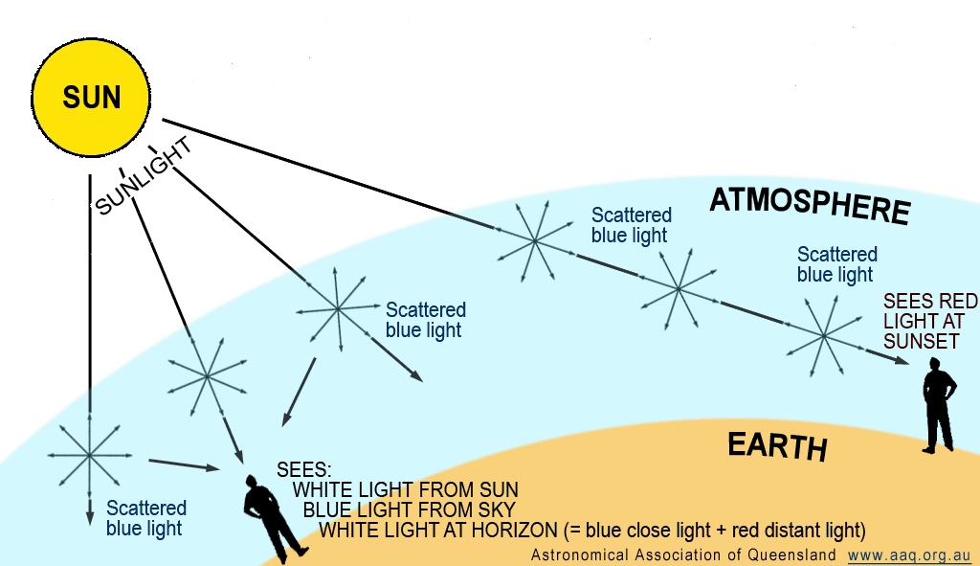
Why are there Sunset Colours Around the Horizon During a Total Solar Eclipse?
Normal Day - Blue Skies, Red Sunsets, White Horizon

Slide 21
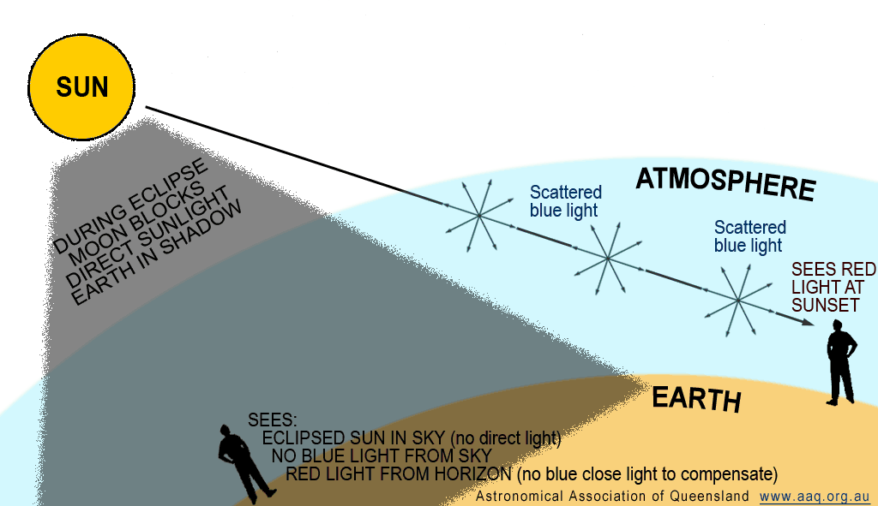
Total Solar Eclipse - Dark Sky, Red Horizon
Why are there Sunset Colours Around the Horizon During a Total Solar Eclipse?

Slide 22
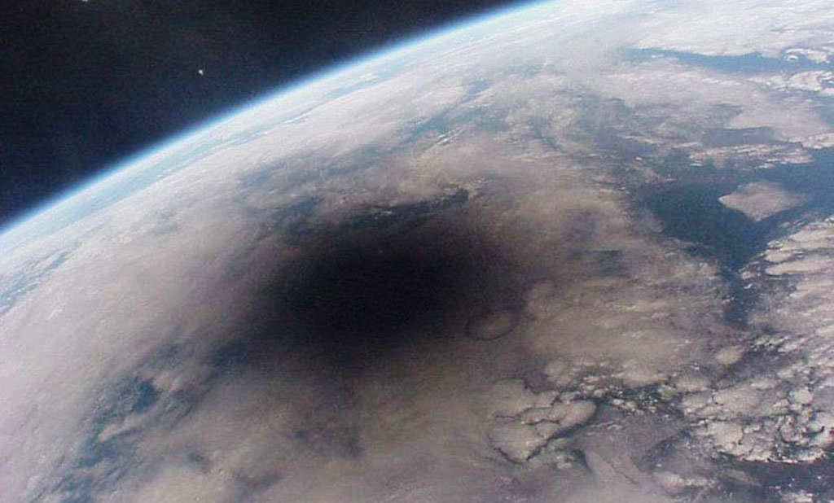
Total Solar Eclipse – Moon Shadow
Moon’s shadow on the Earth Total Solar Eclipse 1999
The image is taken from the Russian Mir spacecraft.

Slide 23
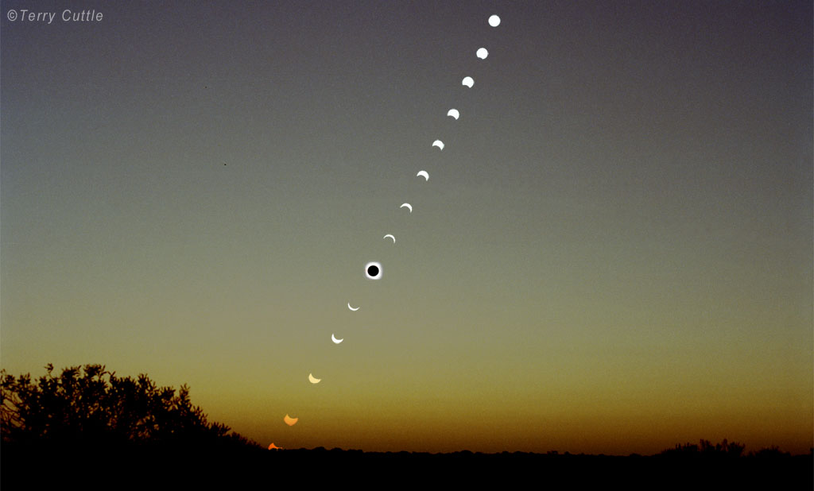
Total Solar Eclipse – 2002
Total Solar Eclipse December 2002, South Australia
This shows the sequence of the eclipse from the initial partial phases through the total eclipse and on to sunset (with the Sun still in partial eclipse).

Slide 24
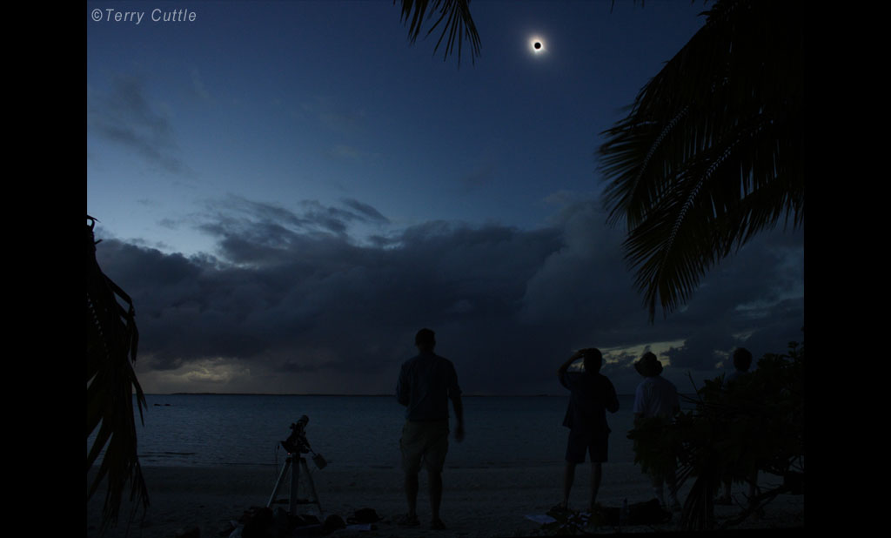
Total Solar Eclipse – 2010
Total Solar Eclipse July 2010, French Polynesia
The eclipsed Sun is seen from the beach over the ocean.
The Sun’s corona surrounds the Moon, The sky is dark, made more dramatic by the clouds in the area.

Slide 25
Total Solar Eclipse 14 November 2012
Astronomical Association of Queensland www.aaq.org.au Science Teachers Association of Queensland www.staq.qld.edu.au
What Happens During a Solar Eclipse
This presentation is copyright by the Astronomical Association of Queensland and the Science Teachers Association of Queensland. It may be freely reproduced and/or modified provided that it is for non-commercial purposes and the source is acknowledged.
Address any request for use of the material for commercial purposes to eclipse@aaq.org.au

